Slide 1
Heating and Stirring Module Design Review #4

Slide 2
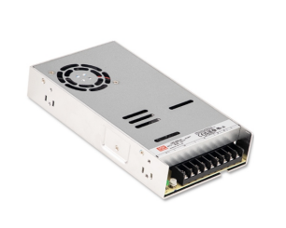
Power Constraints
Underestimated power requirement of hotplates.
10-25W required, 5W initial estimate.
Further testing required.
Total power consumption, 450-700W.
Change from 5V to 24V architecture.
Lower transmission losses.
Lower current.
Requires redesign of current power distribution systems.

Slide 3
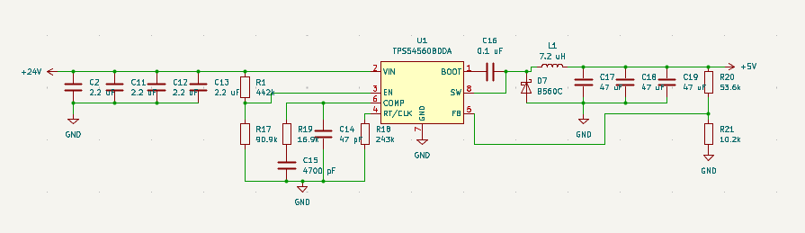
Power contd.
Larger power supply required, increased cost.
LRS-600N2, 600W @ 24V, $64. 12% larger footprint.
Cannot accommodate a 6-module control hub, 4 at most.
H&S 24-5V Buck required, increased complexity.

Slide 4
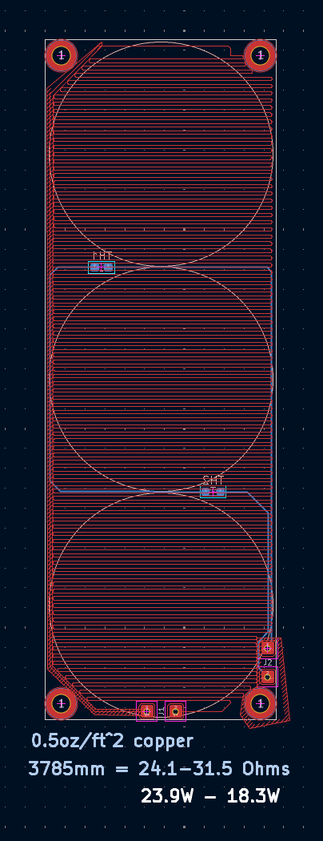
Redesigned Hotplate
Tuned line thickness, routing pattern for:
Higher resistance.
Output power, 25W goal.
Heat dissipation.
Thermistor accuracy.

Slide 5
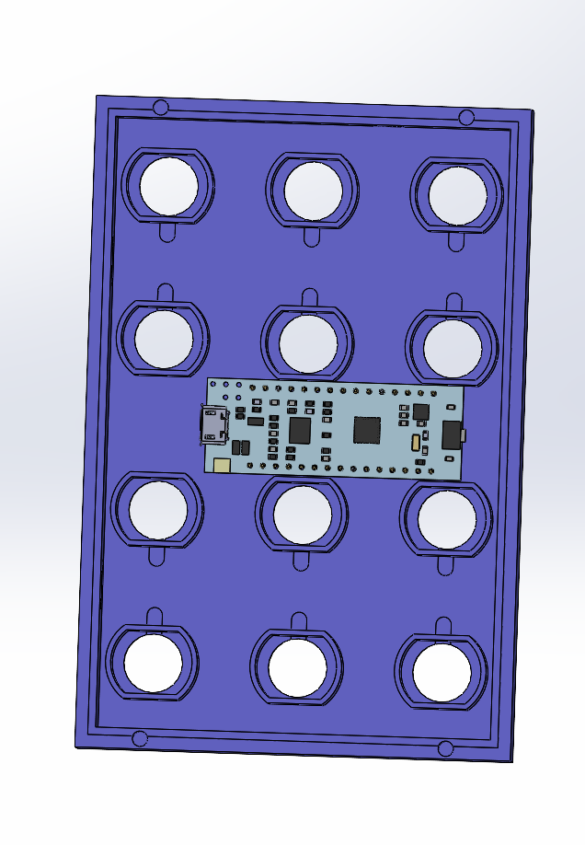
Adjusted Housing Dimensions
Altered motor spacing to accommodate for a Nucleo-32 development board.
Reduced complexity.
All housing components must be updated.

Slide 6
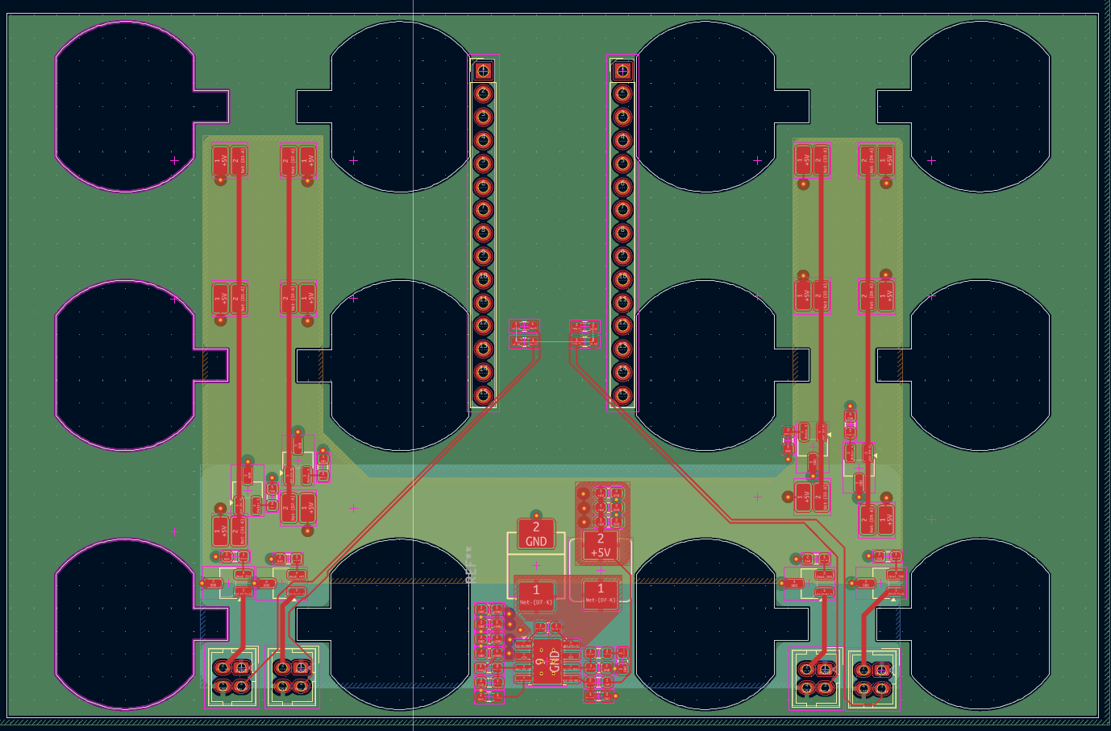
Heating and Stirring PCB
75% complete, missing pinouts, several connectors.
4-layers, assembled by hand.
SMD components unavoidable.
Redesigned power distribution.
24V, 1A hotplate. Main bus.
5V, ~3A total motors. Buck converter.
3.3V, ~400mA logic. Internal LDO VR.

Slide 7
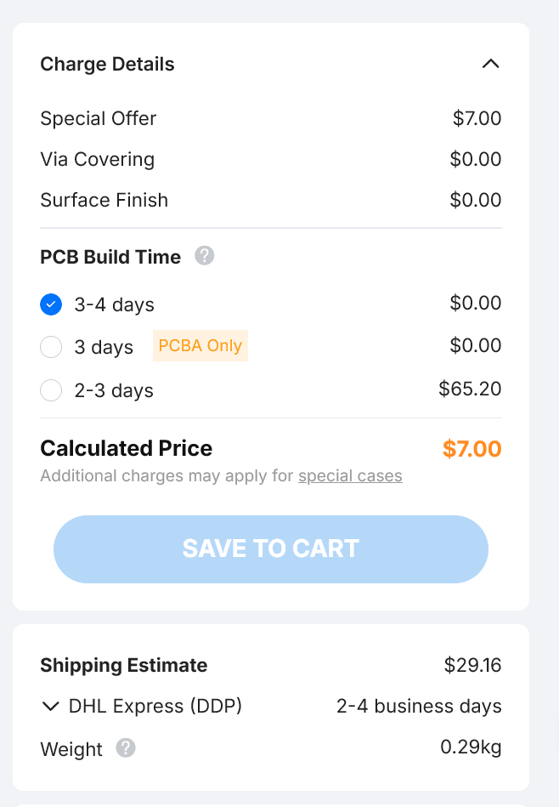
Purchasing PCB’s
Low materials cost
Customs fee & tariffs ~$40
Ordering in bulk
Extensive testing prior to order

Slide 8
Next Steps
Finish H&S and Control Hub PCBs.
Remodel H&S lid and vial guide.
Remodel Control Hub.
Test stir bar interaction.

